Slide 1
Solving Recurrences

Slide 2
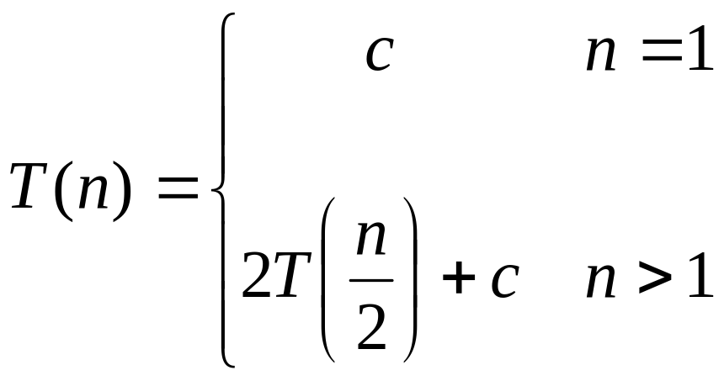
Recurrences
The expression:
is a recurrence.
  Recurrence: an equation that describes a function in terms of its value on smaller functions

Slide 3

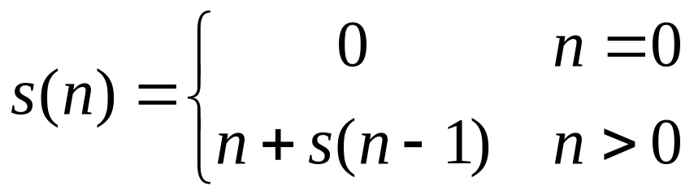

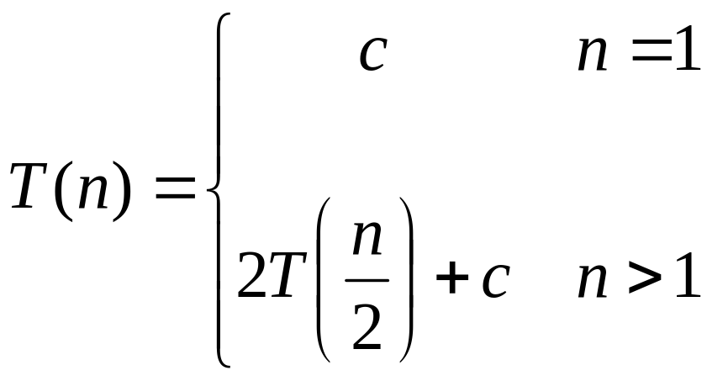
Recurrence Examples

Slide 4
Solving Recurrences
Substitution method
Iteration method
Master method

Slide 5
Solving Recurrences
The substitution method
A.k.a. the “making a good guess method”
  Guess the form of the answer, then use induction to find the constants and show that solution works
  Examples:
    T(n) = 2T(n/2) + Θ(n)  T(n) = Θ(n lg n)

Slide 6
Substitution Method
Guess the form of the solution
Use mathematical induction to find the constants and show that the solution works
Guessing is the hard part, but this gets easier with experience

Slide 7
Substitution Method
Example #1 :
Solve T(n) = 2T(⎣n/2⎦) + n
This looks very much like T(n) = 2T(n/2) + n, which is the recurrence for mergesort. So, let’s assume the same solution: T(n) = nlgn. Show that T(n) ≤ cnlgn for c ≥ 0 and n ≥ n₀ ≥ 1. We do this by induction. We assume that the recurrence holds for ⎣n/2⎦. This leads to
T(⎣n/2⎦) = c⎣n/2⎦lg(⎣n/2⎦).
Sub into recurrence to get
T(n) = 2 c⎣n/2⎦lg(⎣n/2⎦) + n
ctd...

Slide 8
Substitution Method
T(n) = 2 ⎣n/2⎦lg(⎣n/2⎦) + n (repeated from last page)
Simplify. We know that ⎣n⎦ ≤ n, so definitely ⎣n/2⎦ ≤ n/2. Why? consider cases.
What if n is even? Then let n = 2m, and sub back in:
⎣n/2⎦ = ⎣2m/2⎦ = ⎣m⎦ ≤ m = n/2.
What about odd n? Then n = 2m+1. Sub in to get:
⎣n/2⎦ = ⎣(2m+1)/2⎦ = ⎣m + ½ ⎦ ≤ m + ½ = (2m+1)/2 = n/2
So, ⎣n/2⎦ ≤ n/2 for even or odd n.
(It really worked!!! I am definitely shocked!)

Slide 9
Substitution Method
So, back to the problem.
T(n) = 2 c⎣n/2⎦lg(⎣n/2⎦) + n
≤ 2c(n/2)lg(⎣n/2⎦) + n
≤ 2c(n/2)lg(n/2) + n
But
lg(n/2) = lgn – lg2 = lgn – log₂2¹ = lgn –1 (Sorry for the details)
So,
T(n) ≤ 2c(n/2)(lgn - 1) + n
= cn(lgn-1)+n
= cnlgn +n(1-c)
≤ cnlgn for 1-c ≤ 0 or c ≥ 1

Slide 10
Substitution Method
Now we just need to verify boundary conditions.
T(n) ≤ cnlgn
Plug in n = 1:
T(1) = 0 since ln1 = 0. But the recurrence gives something different:
T(1) = 2T(0)+1 = 0+1 = 1 ≠ 0, so this fails. Must have T(1)=1.
So our solution is not valid for n=1. But it doesn’t have to be valid for every n; only for some n ≥ n₀

Slide 11
Substitution Method
So, consider n=2. T(2) = 2cln2 = 2c. The bc of the recurrence gives
T(1) = 1, so use this in Recurrence yields
T(2) = 2T(1) + 2 = 4
T(3) = 2T(1) + 3 = 5
T(4) = 2T(2) + 4
Just let n ≥ 4. Then our solution does not depend on T(1).
We now have to prove our solution holds for n ≥ 4 by picking the appropriate value for c so that the boundary conditions at n=2 and n=3 hold.

Slide 12
Substitution Method
Now just pick a value for c that holds for n = 2 and n = 3
T(2) = 4 ≤ c2 • lg2 = 2c
T(3) = 5 ≤ c3 • lg3
The first equation gives us
c ≥ 2.
If we put c=2 into the second equation, we get
5 ≤ 6 • lg3
But lg 3 > 1. So 6 • lg3 > 6, so definitely 6 • lg3 ≥ 5.
So, for n ≥ 4 and c = 2, we have proven, by induction, that T(n) = n • lgn

Slide 13
Solving Recurrences
Another option is what the book calls the “iteration method”
  Expand the recurrence
  Work some algebra to express as a summation
  Evaluate the summation
We will show several examples

Slide 14

s(n) =
c + s(n-1)
c + c + s(n-2)
2c + s(n-2)
2c + c + s(n-3)
3c + s(n-3)
…
kc + s(n-k) = ck + s(n-k)

Slide 15
So far for n >= k we have
  s(n) = ck + s(n-k)
What if k = n?
  s(n) = cn + s(0) = cn

Slide 16
So far for n >= k we have
  s(n) = ck + s(n-k)
What if k = n?
  s(n) = cn + s(0) = cn
So
Thus in general
  s(n) = cn

Slide 17
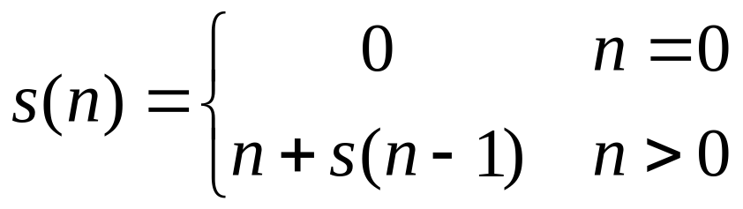
s(n)
= n + s(n-1)
= n + n-1 + s(n-2)
= n + n-1 + n-2 + s(n-3)
= n + n-1 + n-2 + n-3 + s(n-4)
= …
= n + n-1 + n-2 + n-3 + … + n-(k-1) + s(n-k)

Slide 18
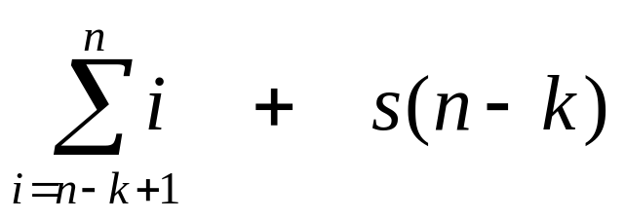
s(n)
= n + s(n-1)
= n + n-1 + s(n-2)
= n + n-1 + n-2 + s(n-3)
= n + n-1 + n-2 + n-3 + s(n-4)
= …
= n + n-1 + n-2 + n-3 + … + n-(k-1) + s(n-k)
=

Slide 19
So far for n >= k we have

Slide 20
So far for n >= k we have
What if k = n?

Slide 21
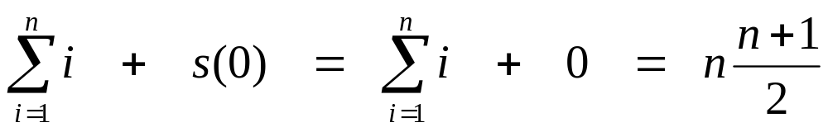
So far for n >= k we have
What if k = n?

Slide 22
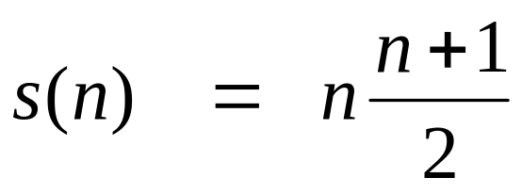
So far for n >= k we have
What if k = n?
Thus in general

Slide 23
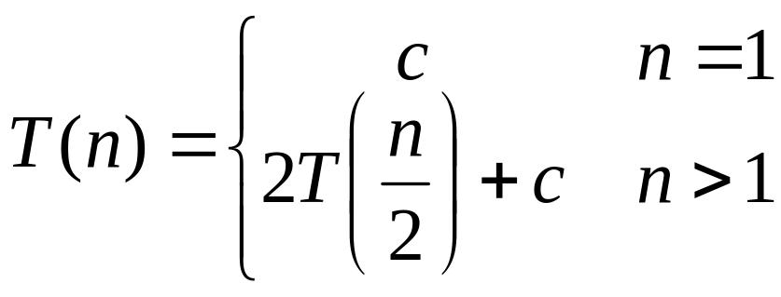
T(n) =
2T(n/2) + c
2(2T(n/2/2) + c) + c
2²T(n/2²) + 2c + c
2²(2T(n/2²/2) + c) + 3c
2³T(n/2³) + 4c + 3c
2³T(n/2³) + 7c
2³(2T(n/2³/2) + c) + 7c
2⁴T(n/2⁴) + 15c
…
2^{k}T(n/2^{k}) + (2^{k} - 1)c

Slide 24
So far for n > 2k we have
  T(n) = 2^{k}T(n/2^{k}) + (2^{k} - 1)c
What if k = lg n?
  T(n) = 2^{lg n} T(n/2^{lg n}) + (2^{lg n} - 1)c
  = n T(n/n) + (n - 1)c
  = n T(1) + (n-1)c
  = nc + (n-1)c = (2n - 1)c

Slide 25
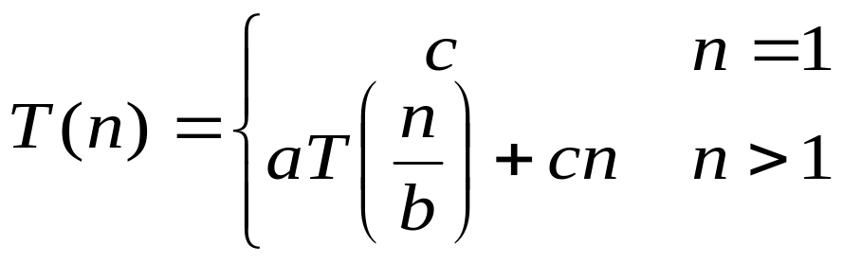
T(n) =
aT(n/b) + cn
a(aT(n/b/b) + cn/b) + cn
a²T(n/b²) + cna/b + cn
a²T(n/b²) + cn(a/b + 1)
a²(aT(n/b²/b) + cn/b²) + cn(a/b + 1)
a³T(n/b³) + cn(a²/b²) + cn(a/b + 1)
a³T(n/b³) + cn(a²/b² + a/b + 1)
…
a^{k}T(n/b^{k}) + cn(a^{k-1}/b^{k-1} + a^{k-2}/b^{k-2} + … + a²/b² + a/b + 1)

Slide 26
So we have
  T(n) = a^{k}T(n/b^{k}) + cn(a^{k-1}/b^{k-1} + ... + a²/b² + a/b + 1)
For k = log_{b} n
  n = b^{k}
  T(n) = a^{k}T(1) + cn(a^{k-1}/b^{k-1} + ... + a²/b² + a/b + 1)
  = a^{k}c + cn(a^{k-1}/b^{k-1} + ... + a²/b² + a/b + 1)
  = ca^{k} + cn(a^{k-1}/b^{k-1} + ... + a²/b² + a/b + 1)
  = cna^{k} /b^{k} + cn(a^{k-1}/b^{k-1} + ... + a²/b² + a/b + 1)
  = cn(a^{k}/b^{k} + ... + a²/b² + a/b + 1)

Slide 27
So with k = log_{b} n
  T(n) = cn(a^{k}/b^{k} + ... + a²/b² + a/b + 1)
What if a = b?
  T(n) = cn(k + 1)
  = cn(log_{b} n + 1)
  = Θ(n log n)

Slide 28
So with k = log_{b} n
  T(n) = cn(a^{k}/b^{k} + ... + a²/b² + a/b + 1)
What if a < b?

Slide 29
So with k = log_{b} n
  T(n) = cn(a^{k}/b^{k} + ... + a²/b² + a/b + 1)
What if a < b?
  Recall that Σ(x^{k} + x^{k-1} + … + x + 1) = (x^{k+1} -1)/(x-1)

Slide 30
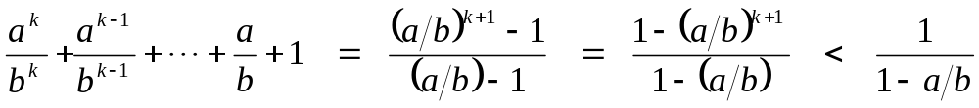
So with k = log_{b} n
  T(n) = cn(a^{k}/b^{k} + ... + a²/b² + a/b + 1)
What if a < b?
  Recall that Σ(x^{k} + x^{k-1} + … + x + 1) = (x^{k+1} -1)/(x-1)
  So:

Slide 31

So with k = log_{b} n
  T(n) = cn(a^{k}/b^{k} + ... + a²/b² + a/b + 1)
What if a < b?
  Recall that Σ(x^{k} + x^{k-1} + … + x + 1) = (x^{k+1} -1)/(x-1)
  So:
  T(n) = cn ·Θ(1) = Θ(n)

Slide 32
So with k = log_{b} n
  T(n) = cn(a^{k}/b^{k} + ... + a²/b² + a/b + 1)
What if a > b?

Slide 33
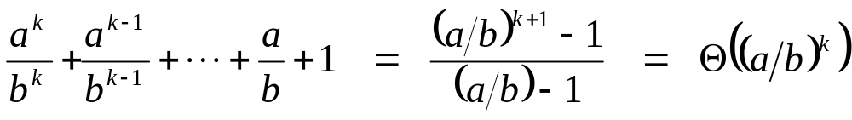
So with k = log_{b} n
  T(n) = cn(a^{k}/b^{k} + ... + a²/b² + a/b + 1)
What if a > b?

Slide 34
So with k = log_{b} n
  T(n) = cn(a^{k}/b^{k} + ... + a²/b² + a/b + 1)
What if a > b?
  T(n) = cn · Θ(a^{k} / b^{k})

Slide 35
So with k = log_{b} n
  T(n) = cn(a^{k}/b^{k} + ... + a²/b² + a/b + 1)
What if a > b?
  T(n) = cn · Θ(a^{k} / b^{k})
  = cn · Θ(a^{log n} / b^{log n}) = cn · Θ(a^{log n} / n)

Slide 36
So with k = log_{b} n
  T(n) = cn(a^{k}/b^{k} + ... + a²/b² + a/b + 1)
What if a > b?
  T(n) = cn · Θ(a^{k} / b^{k})
  = cn · Θ(a^{log n} / b^{log n}) = cn · Θ(a^{log n} / n)
  recall logarithm fact: a^{log n} = n^{log a}

Slide 37
So with k = log_{b} n
  T(n) = cn(a^{k}/b^{k} + ... + a²/b² + a/b + 1)
What if a > b?
  T(n) = cn · Θ(a^{k} / b^{k})
  = cn · Θ(a^{log n} / b^{log n}) = cn · Θ(a^{log n} / n)
  recall logarithm fact: a^{log n} = n^{log a}
  = cn · Θ(n^{log a} / n) = Θ(cn · n^{log a} / n)

Slide 38
So with k = log_{b} n
  T(n) = cn(a^{k}/b^{k} + ... + a²/b² + a/b + 1)
What if a > b?
  T(n) = cn · Θ(a^{k} / b^{k})
  = cn · Θ(a^{log n} / b^{log n}) = cn · Θ(a^{log n} / n)
  recall logarithm fact: a^{log n} = n^{log a}
  = cn · Θ(n^{log a} / n) = Θ(cn · n^{log a} / n)
  = Θ(n^{log a} )

Slide 39
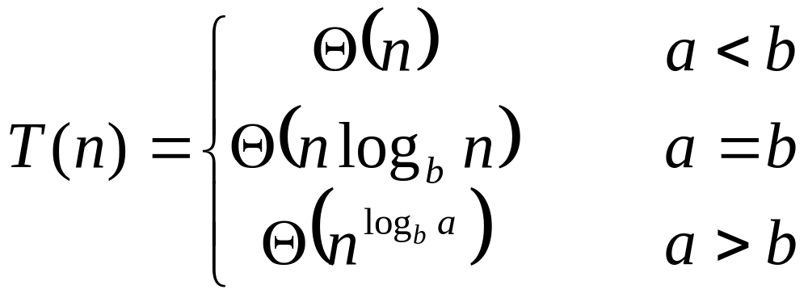
So…

Slide 40
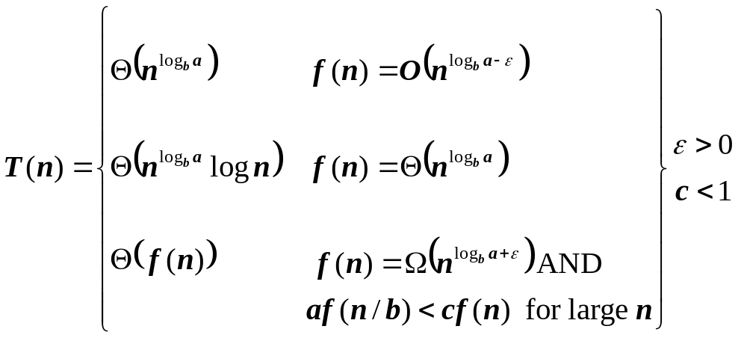
The Master Theorem
if T(n) = aT(n/b) + f(n) then

Slide 41
Using The Master Method
T(n) = 9T(n/3) + n
  a=9, b=3, f(n) = n
  n^{logb a} = n^{log3 9} = Θ(n²)
  Since f(n) = O(n^{log3 9 - ε}), where ε=1, case 1 applies:
  Thus the solution is T(n) = Θ(n²)

